Slide 1

CM20315 - Machine Learning
Prof. Simon Prince
7b Initialization

Slide 2
Initialization
Need for initialization
He initialization
Interlude: Expectations
Show that
Write ariance of pre-activations f’ in terms of activations h in previous layer
Write variance of pre-activations f’ in terms of pre-activations f in previous layer

Slide 3
Initialization
Consider standard building block of NN in terms of preactivations:
How do we initialize the biases and weights?
Equivalent to choosing starting point in Gabor/Linear regression models

Slide 4
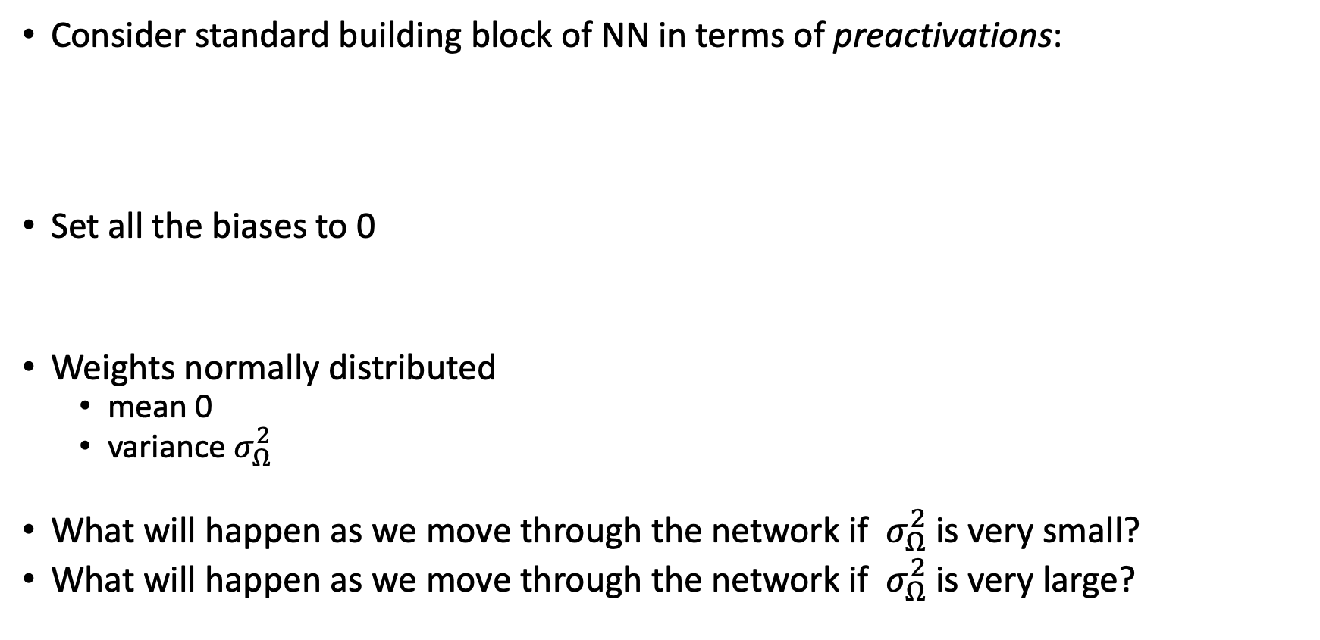
Initialization
Consider standard building block of NN in terms of preactivations:
Set all the biases to 0
Weights normally distributed
mean 0
variance${{ σ}_{Ω}^{2}}_{ }$
What will happen as we move through the network if ${ σ}_{Ω}^{2}$is very small?
What will happen as we move through the network if ${ σ}_{Ω}^{2}$is very large?

Slide 5
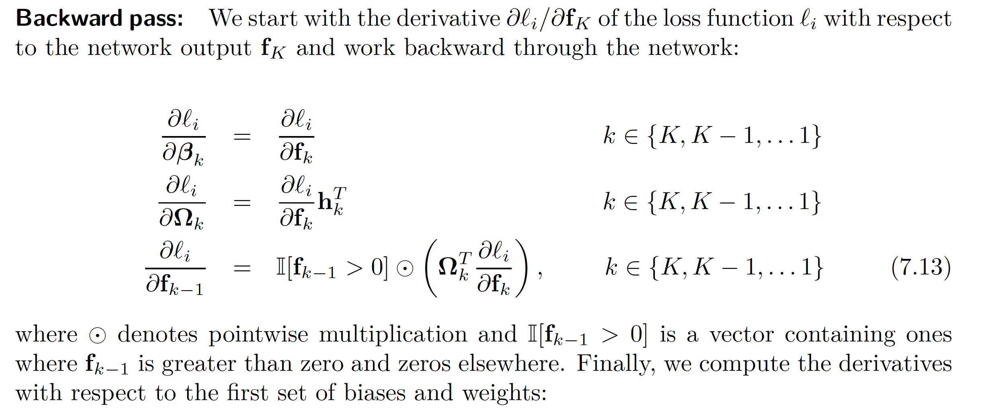
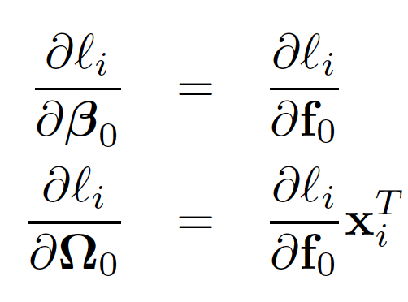
Backprop summary

Slide 6
Initialization
Need for initialization
He initialization
Interlude: Expectations
Show that
Write ariance of pre-activations f’ in terms of activations h in previous layer
Write variance of pre-activations f’ in terms of pre-activations f in previous layer

Slide 7
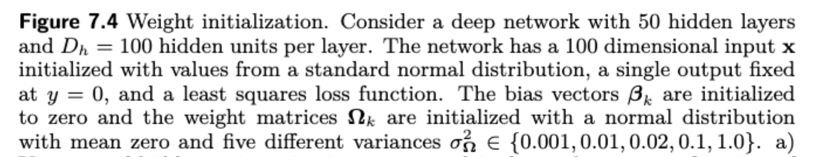
Exploding gradients
Vanishing gradients

Slide 8
He initialization (assumes ReLU)
Forward pass: want the variance of hidden unit activations in layer k+1 to be the same as variance of activations in layer k:
Backward pass: want the variance of gradients at layer k to be the same as variance of gradient in layer k+1:
Number of units at layer k
Number of units at layer k+1

Slide 9
Exploding gradients
Vanishing gradients

Slide 10
Initialization
Need for initialization
He initialization
Interlude: Expectations
Show that
Write variance of pre-activations f’ in terms of activations h in previous layer
Write variance of pre-activations f’ in terms of pre-activations f in previous layer

Slide 11
Expectations
Interpretation: what is the average value of g[x] when taking into account the probability of x?
Could approximate, by sampling many values of x from the distribution, calculating g[x], and taking average:
Notes:
\mathbb{E}\Bigl[\mbox{g}[x]\Bigr] \approx \frac{1}{N}\sum_{n=1}^{N} \mbox{g}[x_n^*]

Slide 12
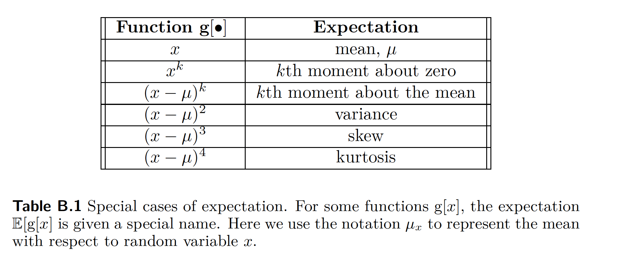
Expectations

Slide 13
Rules for manipulating expectation

Slide 14
Rule 1

Slide 15
Rules for manipulating expectation

Slide 16
Rule 2

Slide 17
Rules for manipulating expectation

Slide 18
Rule 3

Slide 19
Rules for manipulating expectation

Slide 20
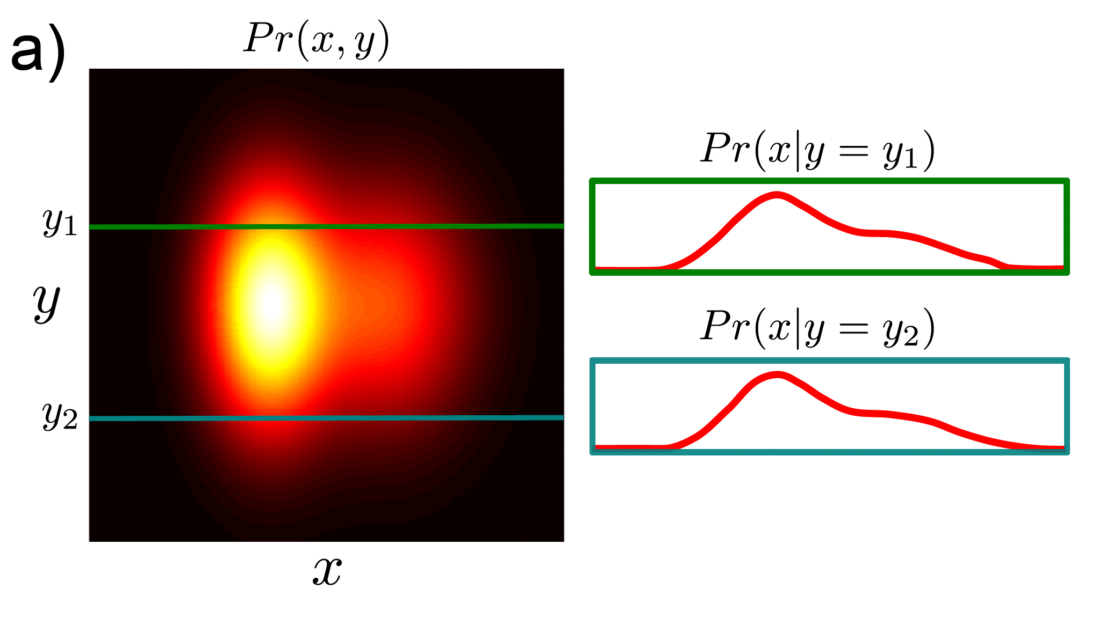
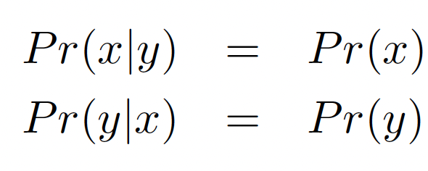
Independence
Probability of x and y

Slide 21
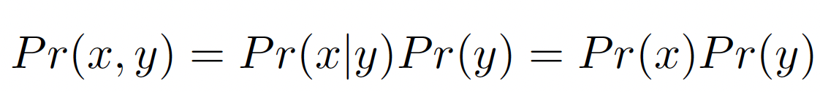
Independence
Probability of x and y

Slide 22
Rule 4
Because independent

Slide 23
Now let’s prove:
Keeping in mind:

Slide 24
Now let’s prove:
Keeping in mind:

Slide 25
Rule 1:
Rule 2:
Rule 3:
Def’n

Slide 26
Rule 1:
Rule 2:
Rule 3:
Def’n

Slide 27
Rule 1:
Rule 2:
Rule 3:
Def’n

Slide 28
Rule 1:
Rule 2:
Rule 3:
Def’n

Slide 29
Rule 1:
Rule 2:
Rule 3:
Def’n

Slide 30
Rule 1:
Rule 2:
Rule 3:
Def’n

Slide 31
Initialization
Need for initialization
He initialization
Interlude: Expectations
Show that
Write variance of pre-activations f’ in terms of activations h in previous layer
Write variance of pre-activations f’ in terms of pre-activations f in previous layer

Slide 32
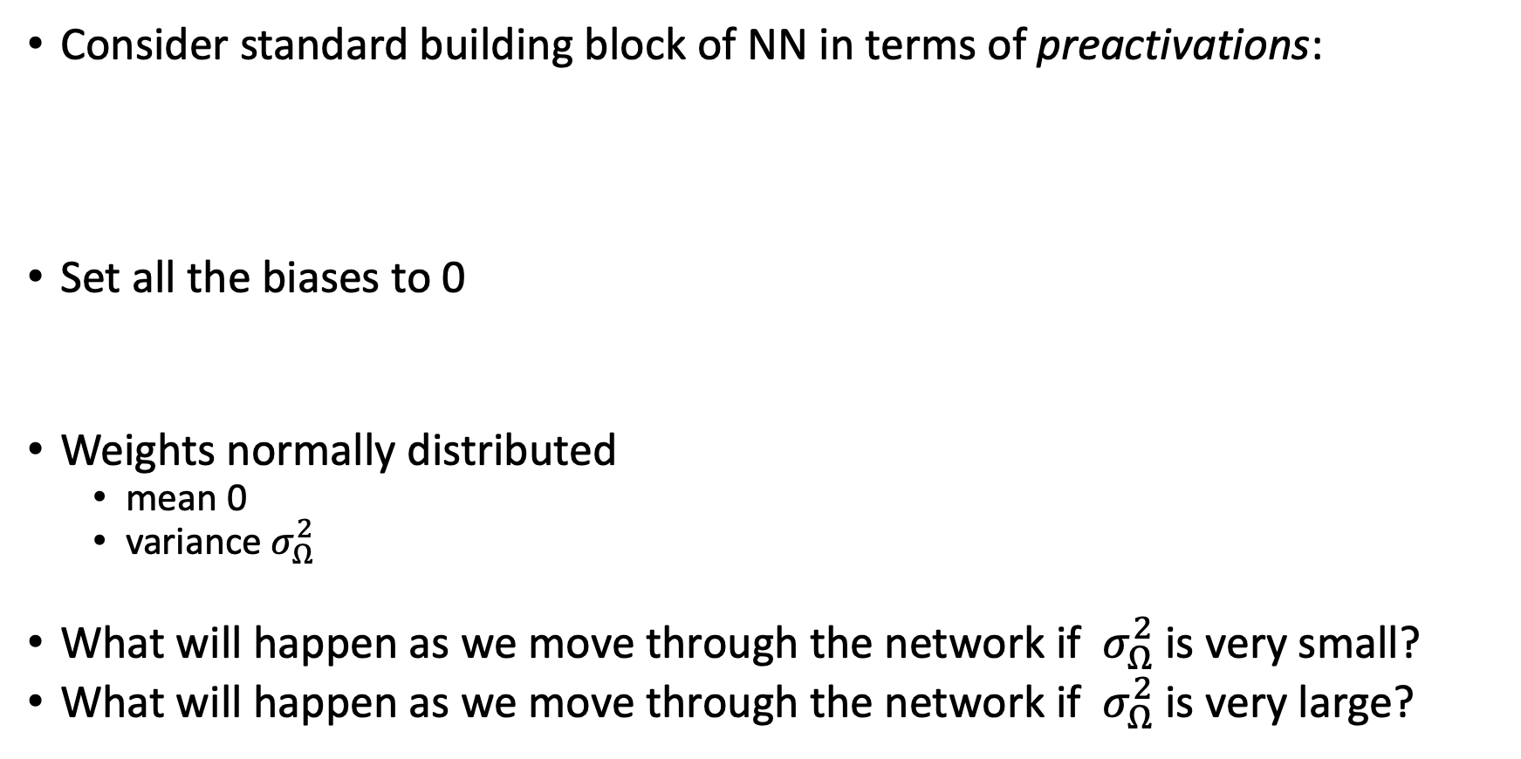
Initialization
Consider standard building block of NN in terms of preactivations:
Set all the biases to 0
Weights normally distributed
mean 0
variance${{ σ}_{Ω}^{2}}_{ }$
What will happen as we move through the network if ${ σ}_{Ω}^{2}$is very small?
What will happen as we move through the network if ${ σ}_{Ω}^{2}$is very large?

Slide 33
Aim: keep variance same between two layers
Consider the mean of the pre-activations:

Slide 34
Rule 1:
Rule 2:
Rule 3:
Rule 4:

Slide 35
Rule 1:
Rule 2:
Rule 3:
Rule 4:

Slide 36
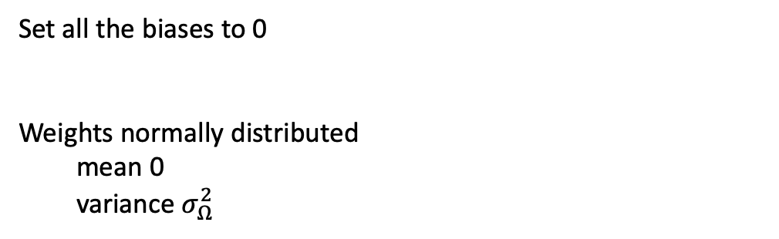
Rule 1:
Rule 2:
Rule 3:
Rule 4:
Set all the biases to 0
Weights normally distributed
mean 0
variance${{ σ}_{Ω}^{2}}_{ }$

Slide 37
Initialization
Need for initialization
He initialization
Interlude: Expectations
Show that
Write variance of pre-activations f’ in terms of activations h in previous layer
Write variance of pre-activations f’ in terms of pre-activations f in previous layer

Slide 38
Aim: keep variance same between two layers

Slide 39
Rule 1:
Rule 2:
Rule 3:
Rule 4:
Set all the biases to 0
Weights normally distributed
mean 0
variance${{ σ}_{Ω}^{2}}_{ }$

Slide 40
Rule 1:
Rule 2:
Rule 3:
Rule 4:
Set all the biases to 0
Weights normally distributed
mean 0
variance${{ σ}_{Ω}^{2}}_{ }$

Slide 41
Rule 1:
Rule 2:
Rule 3:
Rule 4:
Set all the biases to 0
Weights normally distributed
mean 0
variance${{ σ}_{Ω}^{2}}_{ }$

Slide 42
Rule 1:
Rule 2:
Rule 3:
Rule 4:
Set all the biases to 0
Weights normally distributed
mean 0
variance${{ σ}_{Ω}^{2}}_{ }$

Slide 43
Initialization
Need for initialization
He initialization
Interlude: Expectations
Show that
Write variance of pre-activations f’ in terms of activations h in previous layer
Write variance of pre-activations f’ in terms of pre-activations f in previous layer

Slide 44
Notes:
\sigma^{2}_{f'} &= \sigma_\Omega^2 \sum_{j=1}^{D_h} \Expected\left[h_{j}^2\right]\\
& =\sigma_\Omega^2 \sum_{j=1}^{D_h} \Expected\left[\mbox{ReLU}[f_{j}]^2\right]\\
& =\sigma_\Omega^2 \sum_{j=1}^{D_h} \int_{-\infty}^{\infty}\mbox{ReLU}[f_{j}]^2 Pr(f_j) df_{j}\\
& =\sigma_\Omega^2 \sum_{j=1}^{D_h} \int_{-\infty}^{\infty}(\mathbb{I}[f_{j}>0]f_{j})^2 Pr(f_j) df_{j}\\
& =\sigma_\Omega^2 \sum_{j=1}^{D_h} \int_{0}^{\infty}f_{j}^2 Pr(f_j) df_{j}\\
& =\sigma_\Omega^2 \sum_{j=1}^{D_h} \frac{\sigma^2_{f}}{2} = \frac{D_{h}\sigma_\Omega^2\sigma^2_{f}}{2}

Slide 45
Aim: keep variance same between two layers
Should choose:
This is called He initialization.

Slide 46

Feedback

